Slide 1
Art Bible
Project Sleuth

Slide 2
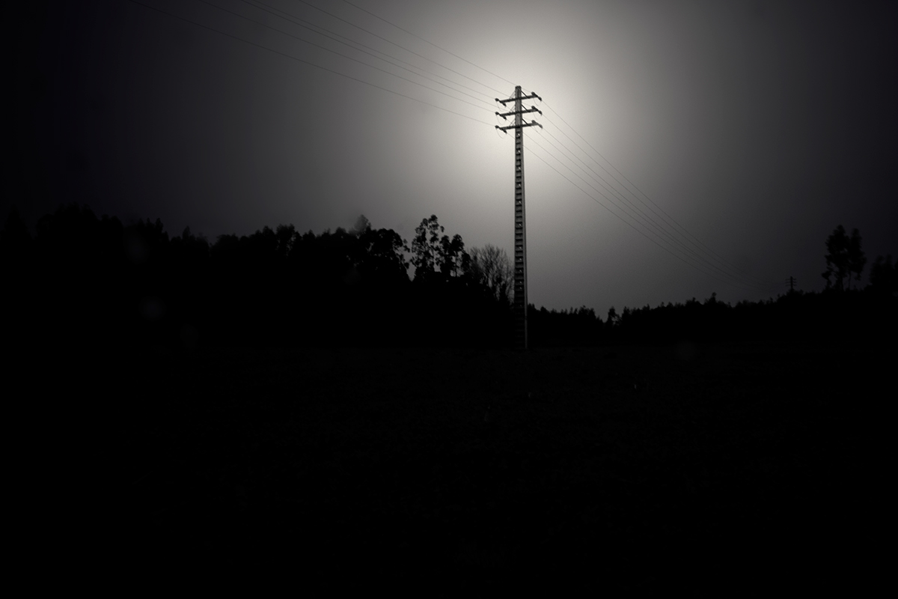
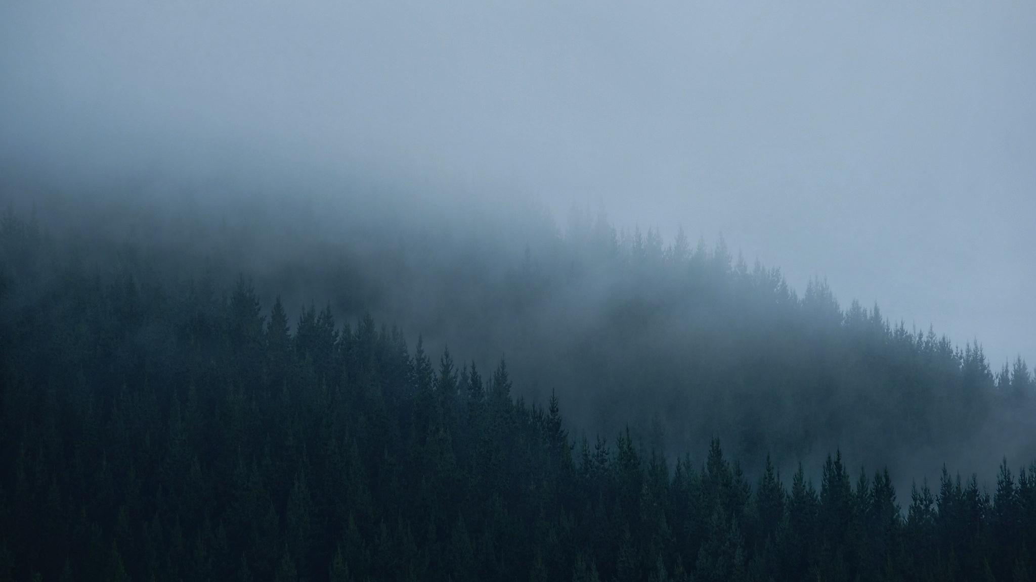
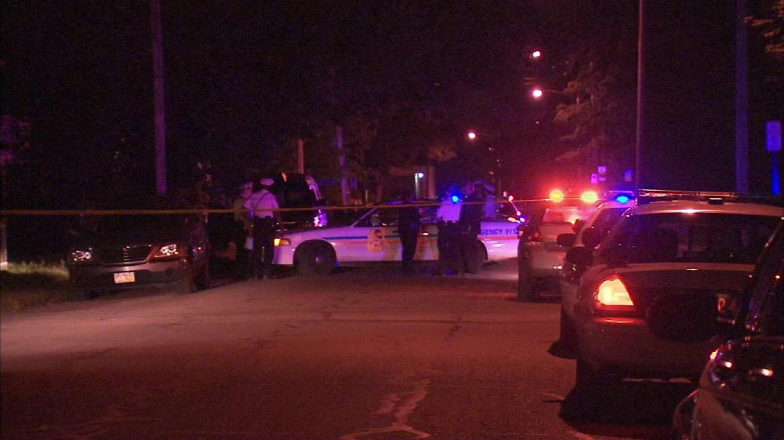
Mood and vibe
Light is amplified in the large amount of darkness
Using these two images give off a grim setting.
Foggy settings causing more difficulty
for sight also gives off a creepy vibe.
Primary feeling being a sense of an horrible crime.

Slide 3
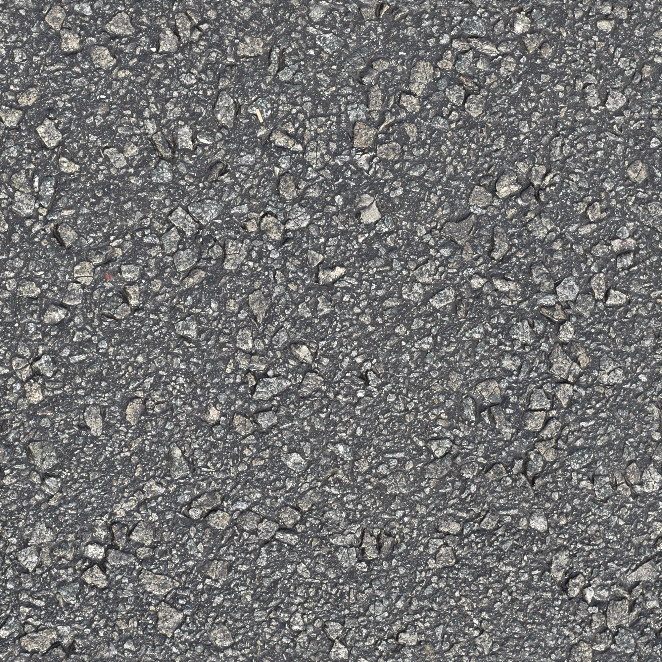
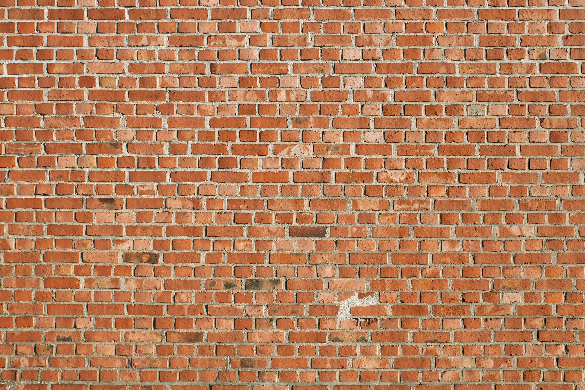
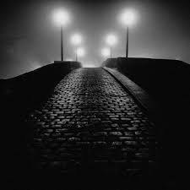
Project Art Style
2000x2000 Texture size
Photo-realistic style over all.
High quality
Foggy, Obstructed light sources
Obstructed moon giving little light

Slide 4
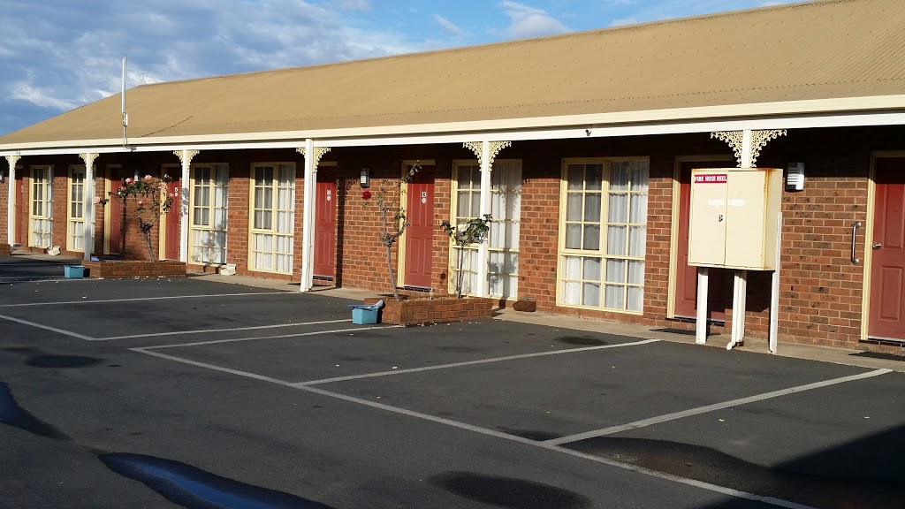
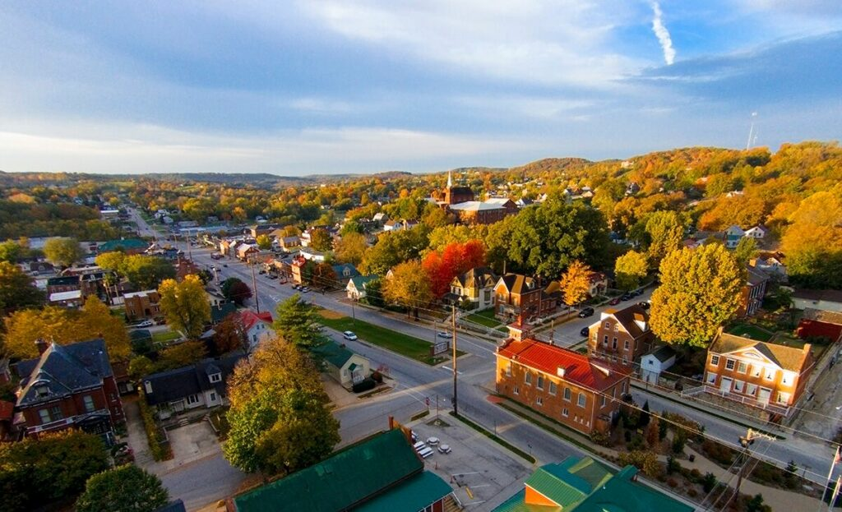
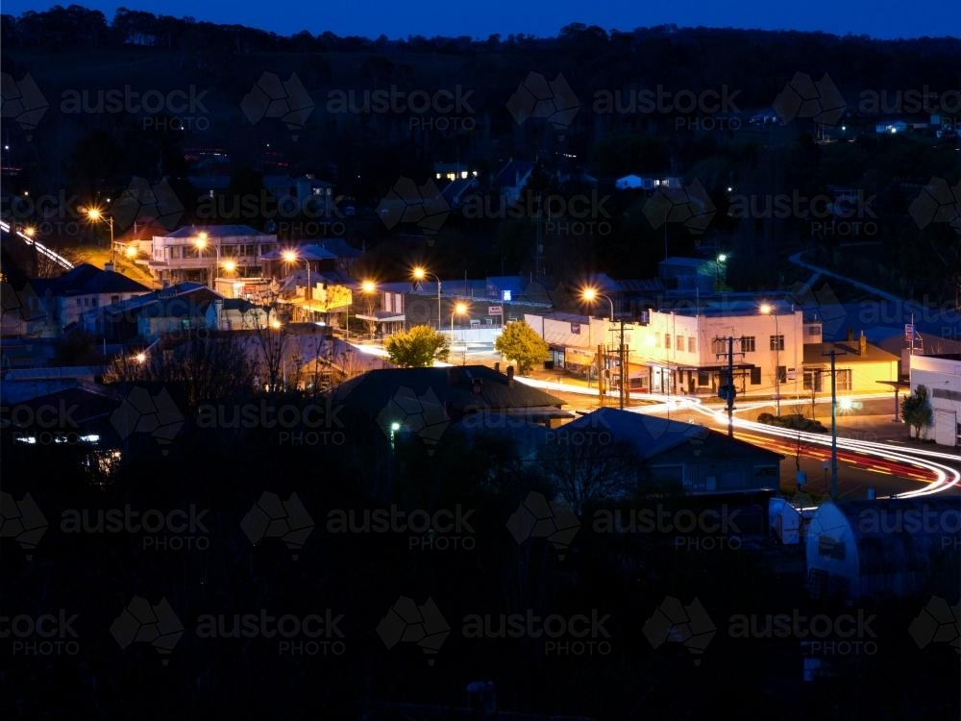
Environment
Motel
Rural Small Town
Night

Slide 5
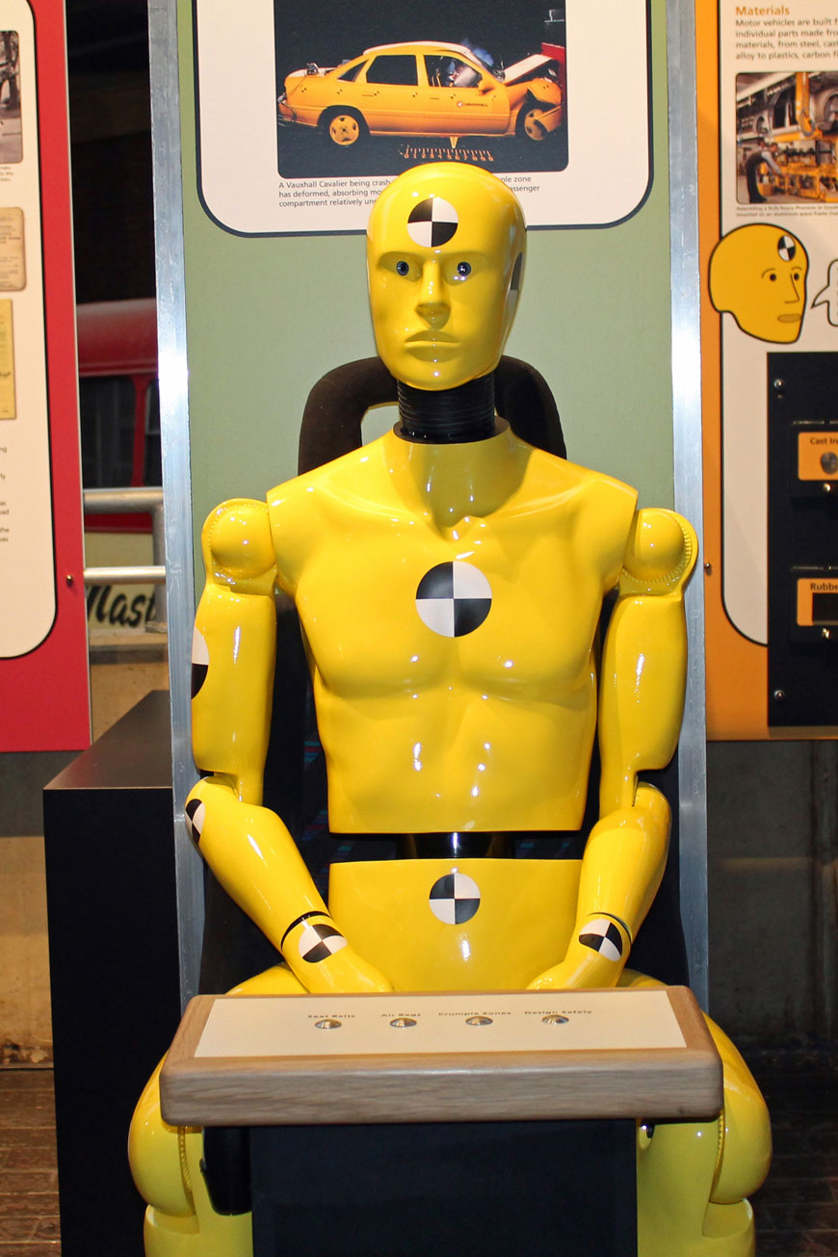
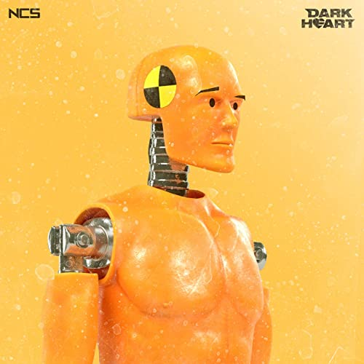
Characters
Humanoid dummy

Slide 6
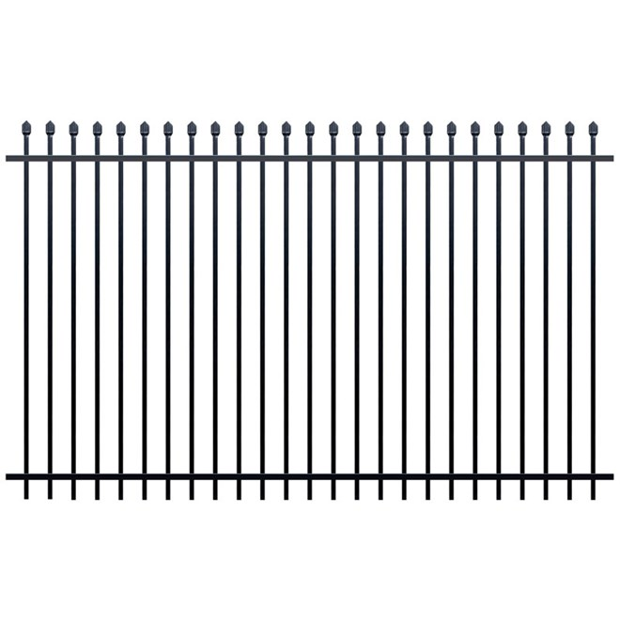
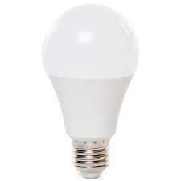
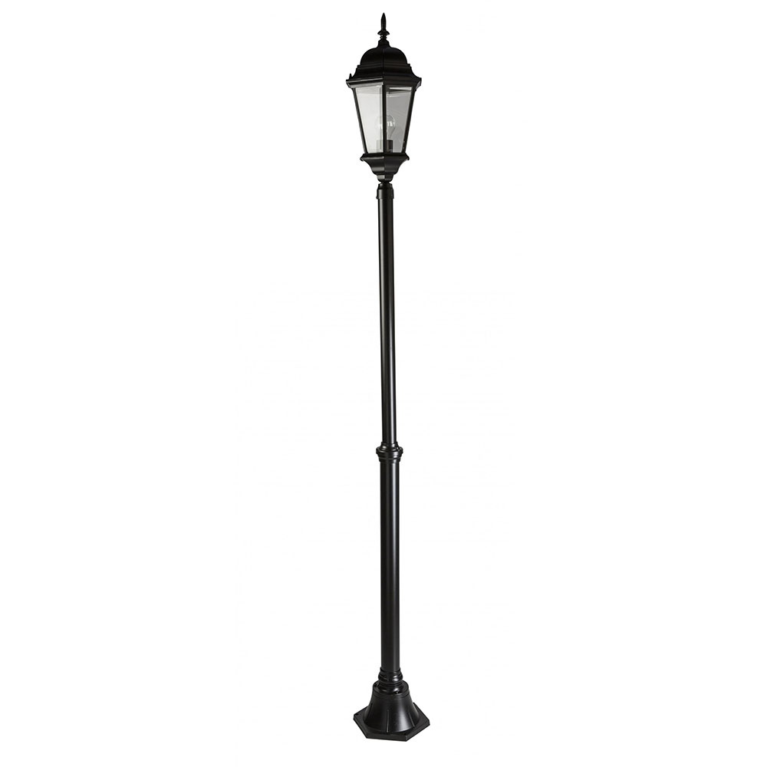
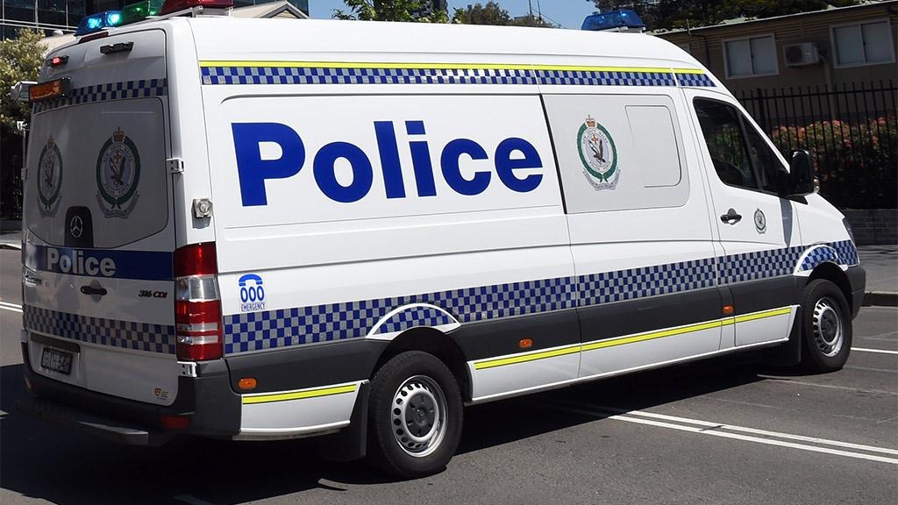
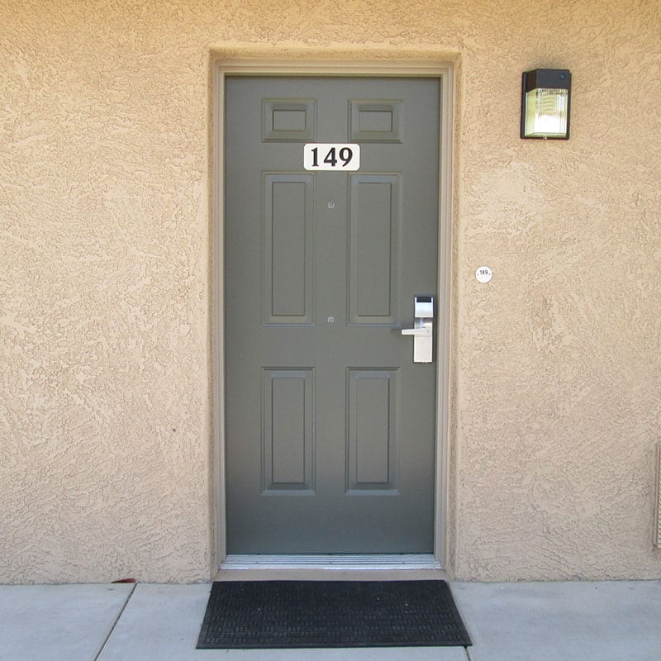
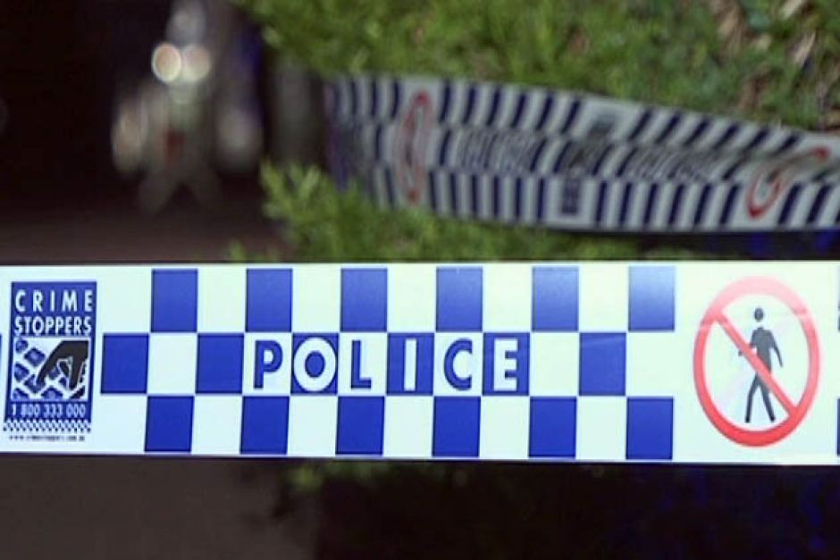
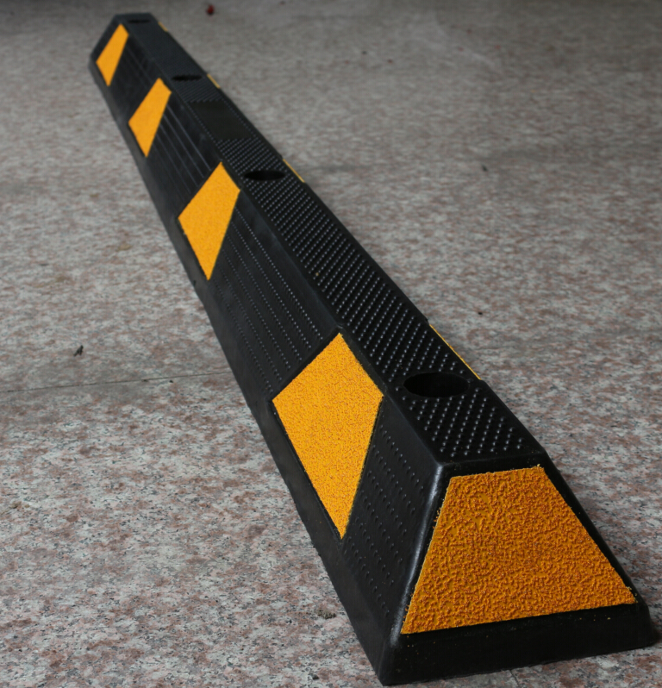
Models
Fence
Light Bulb
Police van
Light pole
Door
Police tape
Car Stopper

Slide 7
Textures
Gritty and harsh

Slide 8
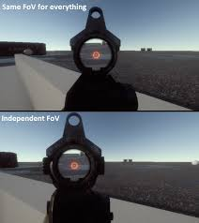
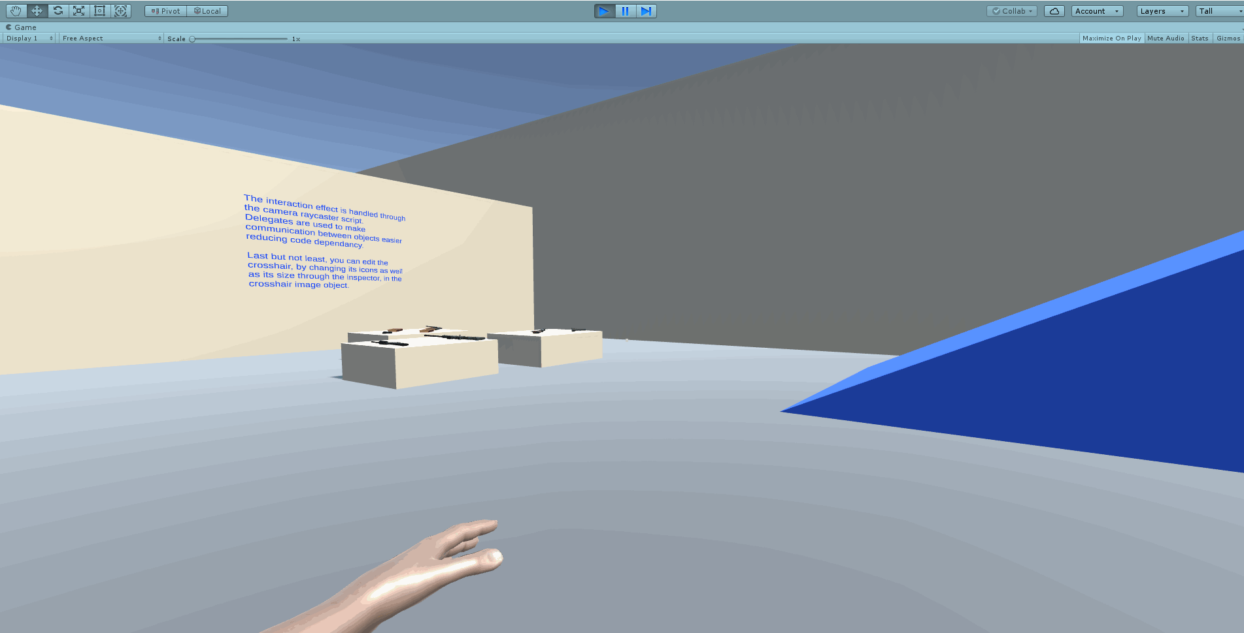
Camera
No guns just showing first person
First person

Slide 9
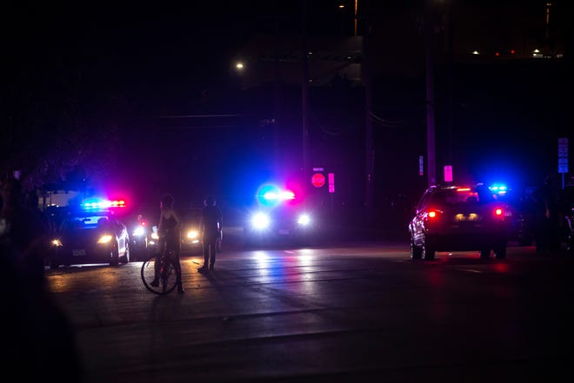
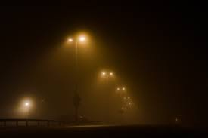
Lighting
Hyper bright police lights
Moon hidden but giving a little light
Fog causing this lighting effect

Slide 10
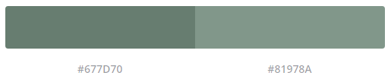


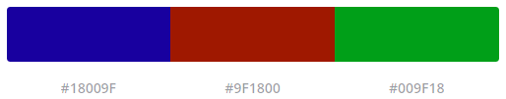
Colour pallet
The lighter blue-grey is for the fog and light
Grass
The bright colours are for the police lights in the level that flashes

Slide 11
Level of detail

Slide 12
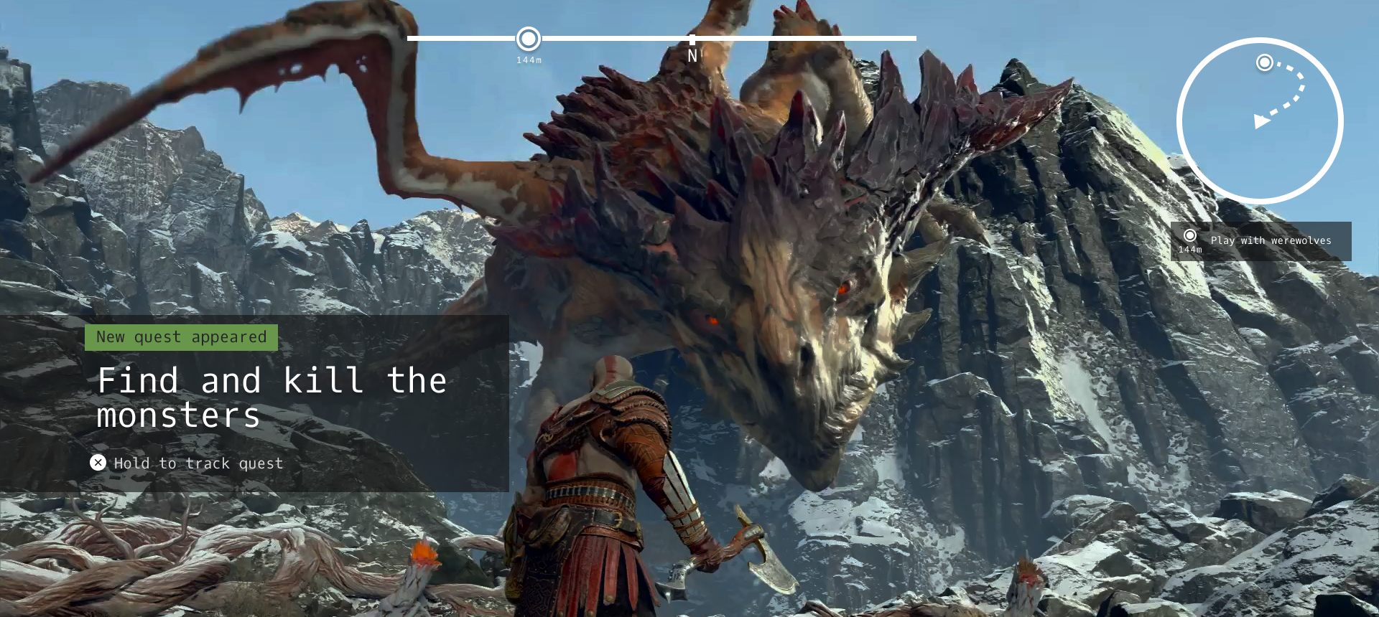
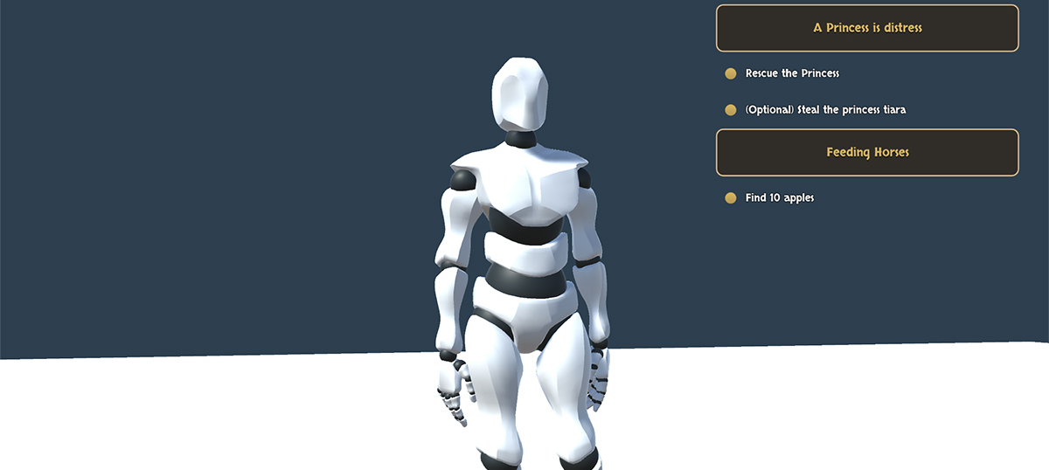
UI Style
Things to do list
Small Map

Slide 13
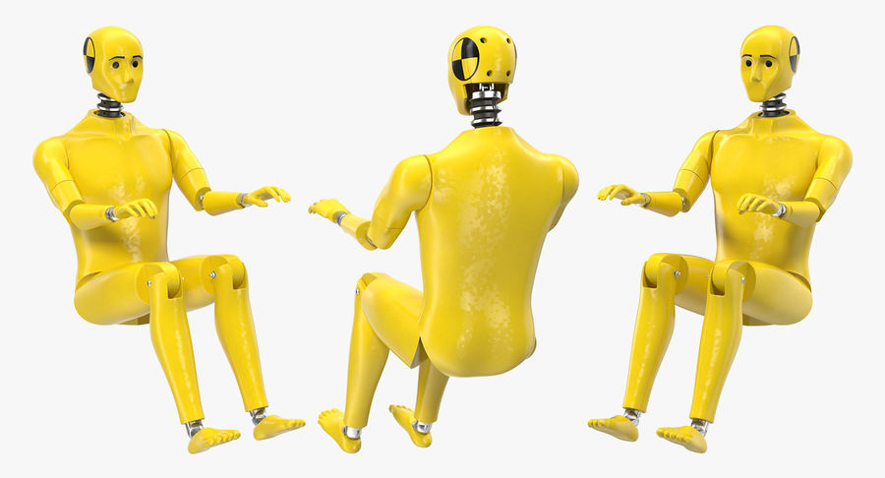
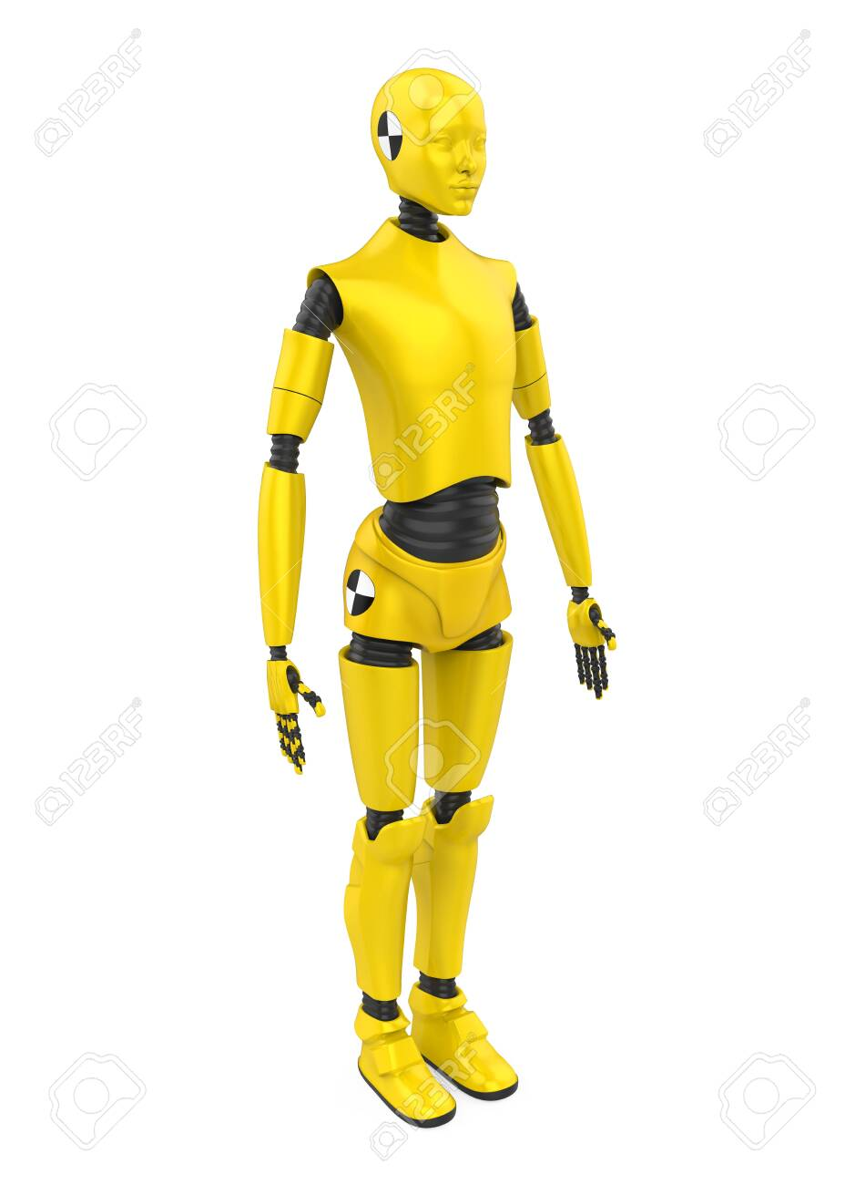
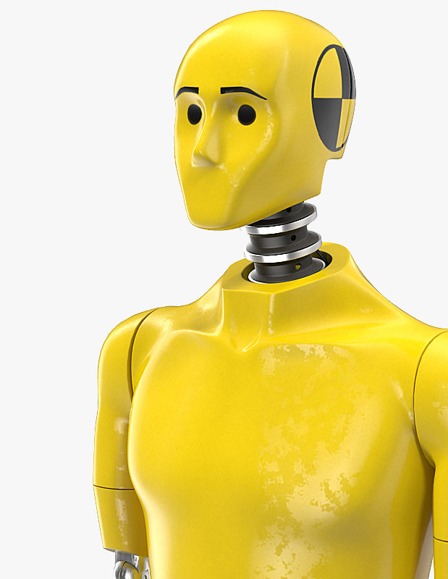
Feature Model Murder victim
Can easily be placed into different positions
Due to joints
Low amount of Complex shapes easy UV mapping
The model will be of a crash test dummy. Skin coloured, This will reduce time needed.

Slide 14
Design Rules

Slide 15
Art Tools
Maya – To be used to create models
Photoshop – To Texture models
Unity – For the models to be tested in and used in
- Pipeline
Maya – Unity – Maya – Photoshop – Maya - Unity

Slide 16
Guidelines

